Slide 1
Welcome :)

Slide 2
Prathyusha Engineering College
Keyboard Controlled by Eye Tracking
for Paralyzed People
Team members :
Sanjay Krishna T N [IT – III]

Slide 3
Keyboard Controlled by Eye Tracking for Paralyzed People
ABSTRACT :
Virtual Keyboard can be controlled by the movements of the human eye.
This is specifically designed for paralyzed people.
By using this, paralyzed people can easily communicate with others.

Slide 4


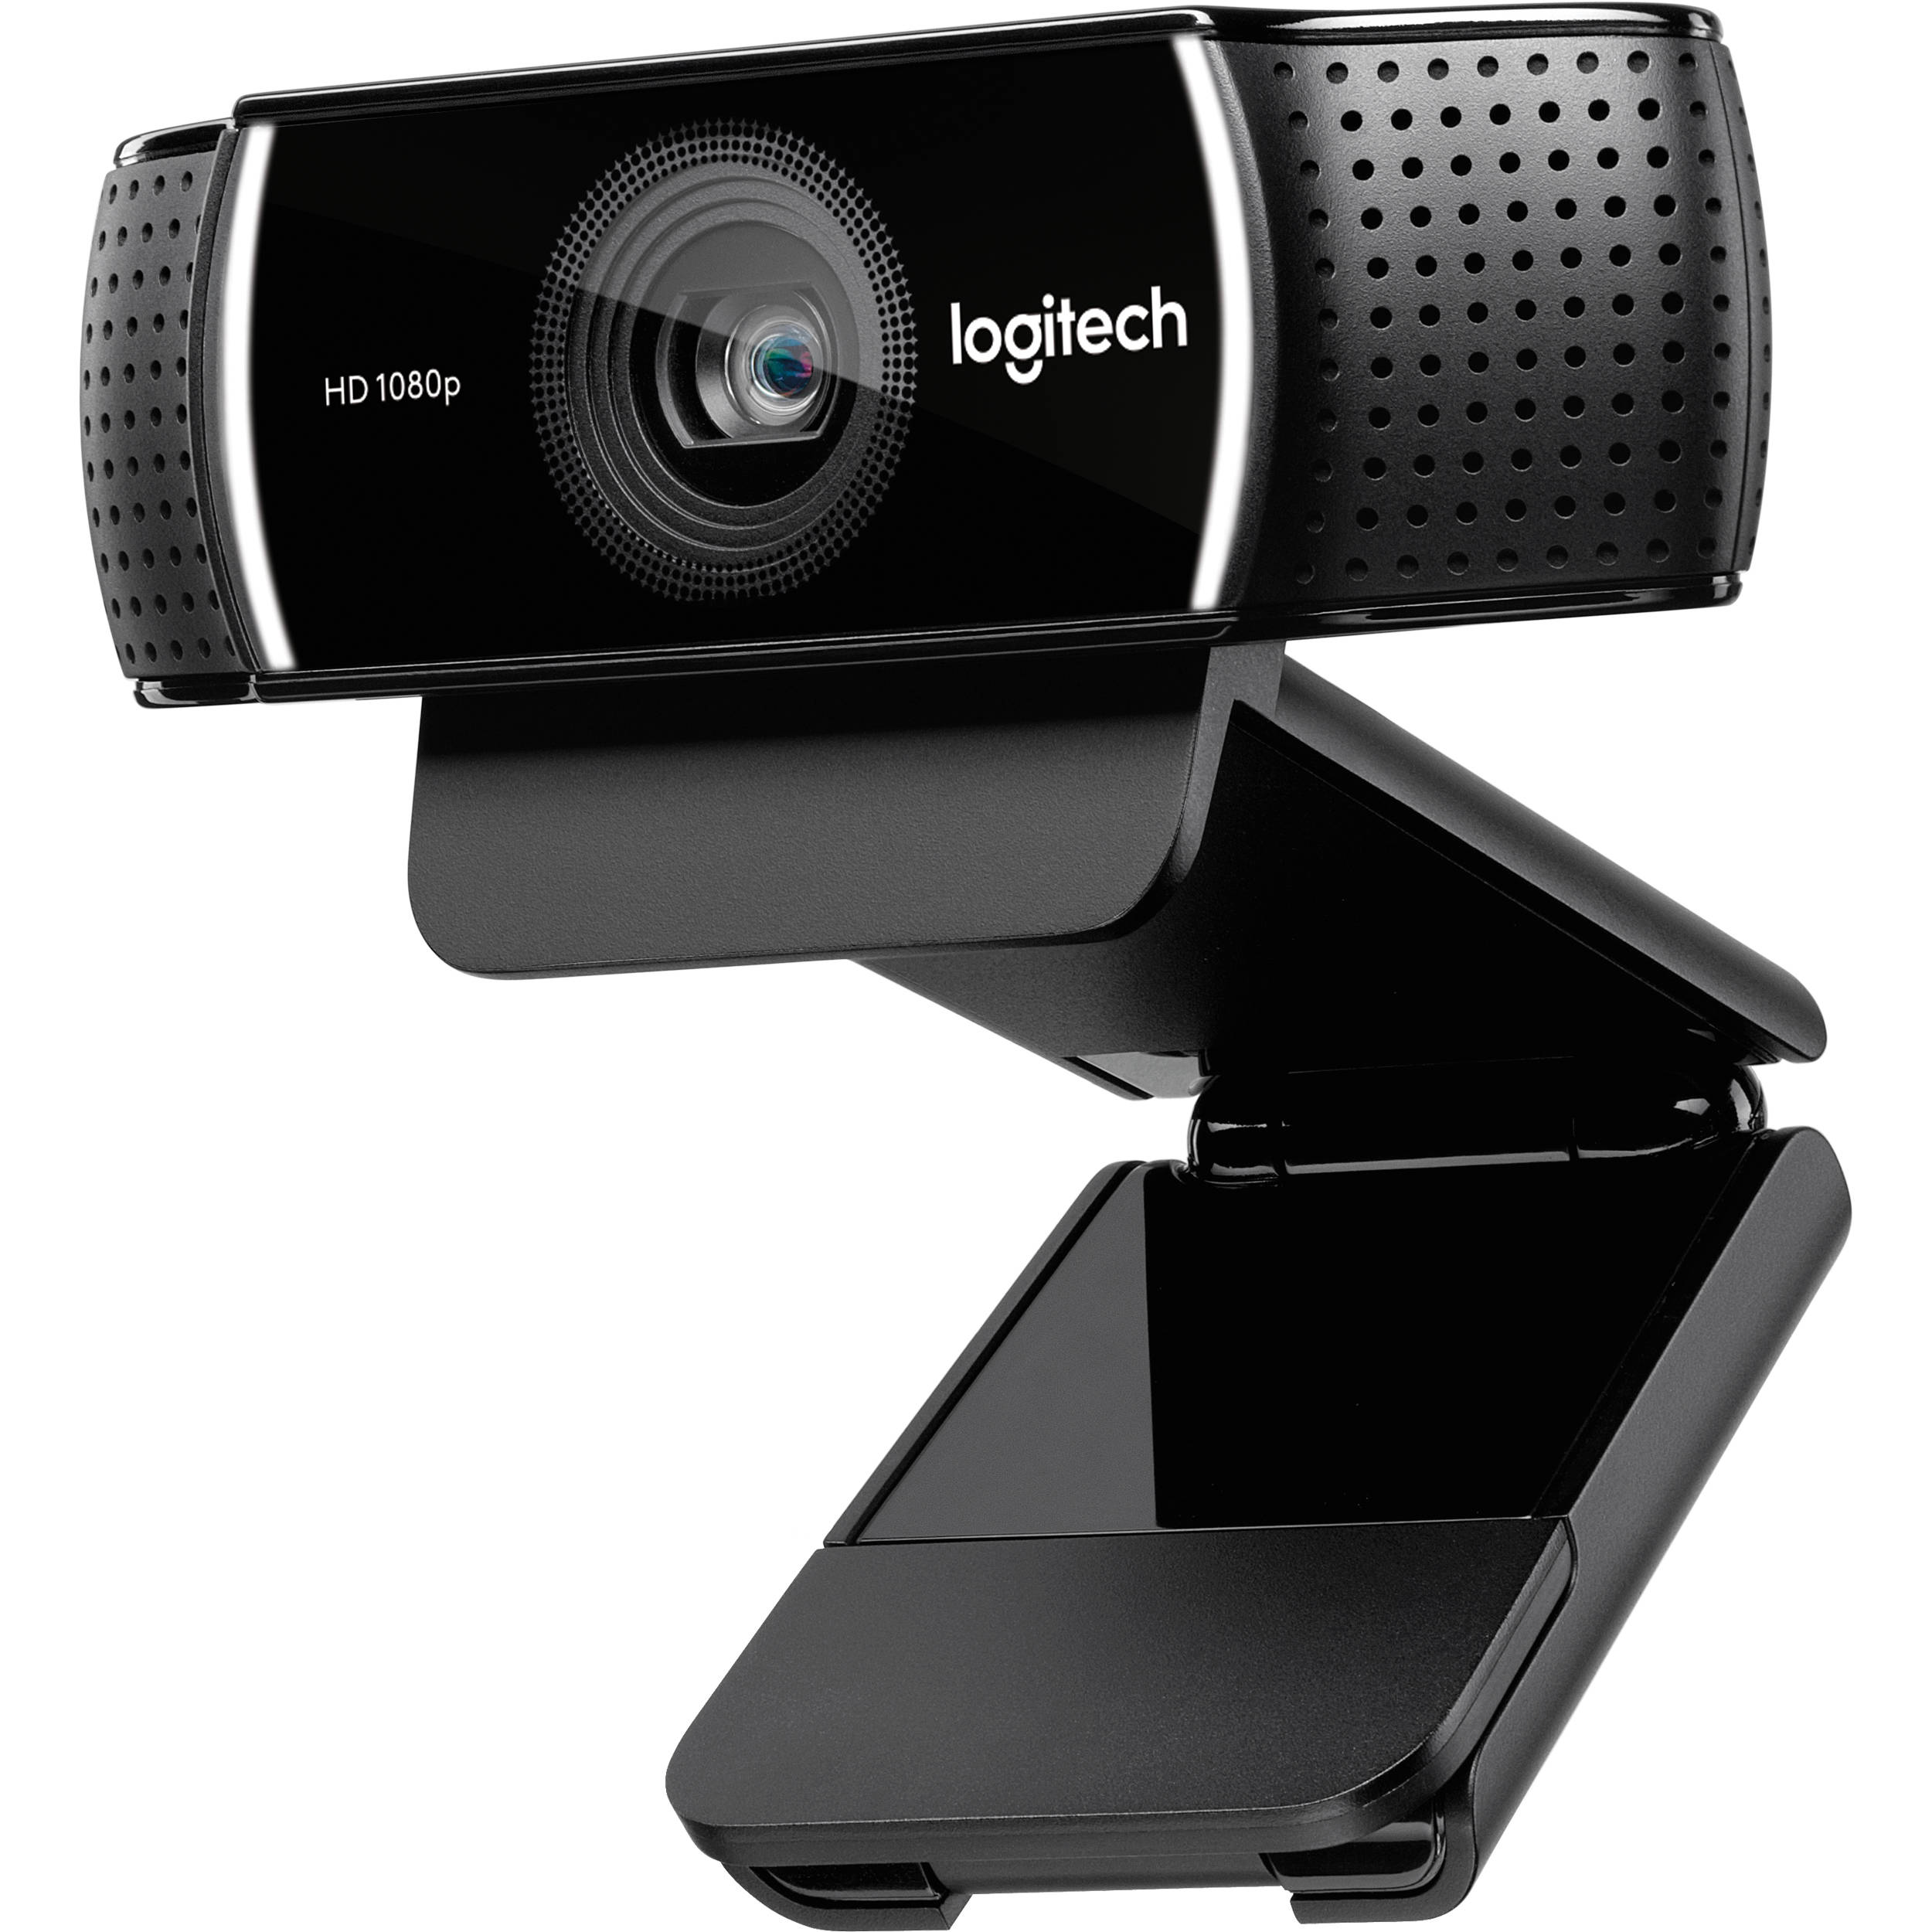
Tools Used
PyCharm IDE
OpenCV Module
DLIB Library
Web Cam

Slide 5
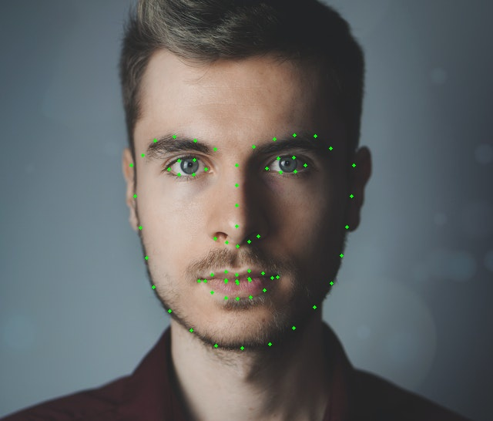
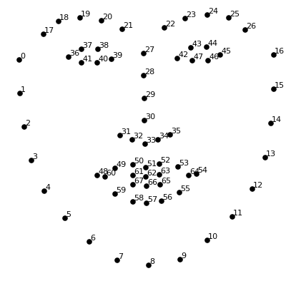
Project Details
OpenCV is an open-source library used for image and video processing.
It can also construct 3D images, detect objects and recognize the it.
Tracking the movements in our face.
Dlib is also an open-source library used to detect the landmarks in our face, like the outline of our eyes, nose, jawline etc.
These are mainly used in Detecting the Human Emotions and the Movements in our face.

Slide 6
Working
OpenCV library scans for any human faces via the Web Cam attached to the device.
Then the Dlib library aligns the landmarks on human face from available data.
Here we use only the landmarks present in the eye region.
Detects the blinking of eye, pupil / iris movements.
The Dlib library identifies the pupil movement and moves the cursor to each letter on the virtual keyboard.
Letters are selected / printed by blinking our eyes.
By this, the paralyzed people can communicate with others easily.

Slide 7
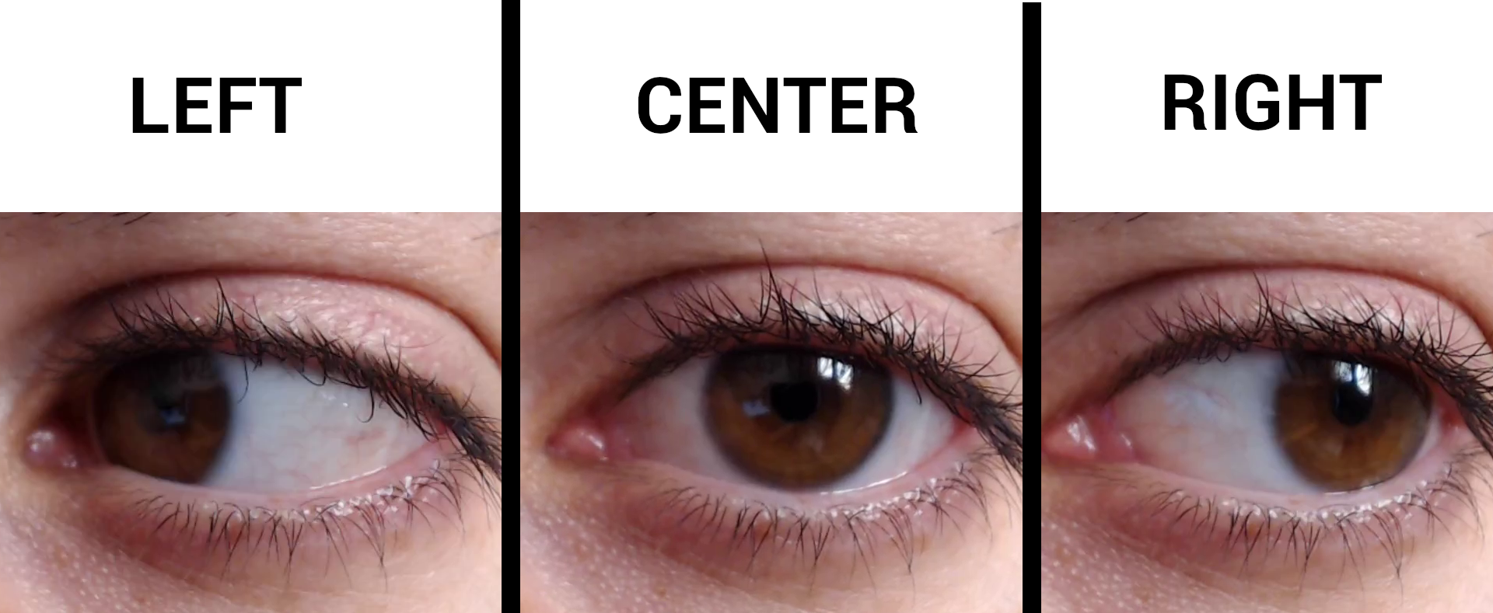
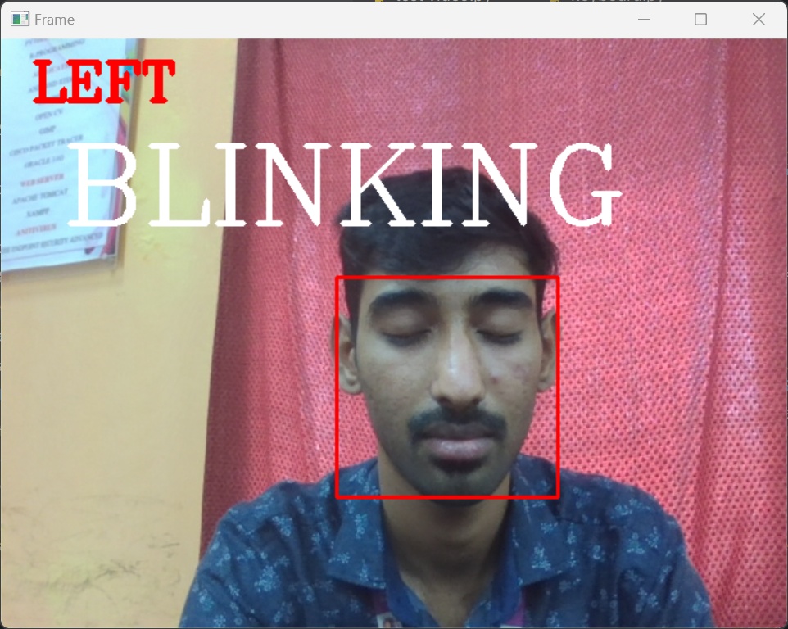
DEMO
This software detects the pupil movements and displays whether it is LEFT, RIGHT.
Also displays the text, BLINKING if both eyes are closed.
The letters on the virtual keyboard are lighted up in a particular intervals, and by blinking our eyes, we can select the letter and it will print on the white board.

Slide 8
Thank you :)

